Slide 1




NEXT GEN EMPLOYABILITY PROGRAM
Creating a future-ready workforce
Team Members
College Name
Student Name : Fahmi Hanan .K
Student ID : au960221243020
Arunachala College of Engineering For Women.

Slide 2

CAPSTONE PROJECT SHOWCASE
Project Title
Car Rentals Application with Django Framework
Abstract | Problem Statement | Project Overview | Proposed Solution | Technology Used | Modelling & Results | Conclusion

Slide 3
Abstract
This abstract outlines the development of a car rental system using the Django web framework.
The system facilitates the rental process by providing a user-friendly interface for customers to browse available vehicles, make reservations, and complete transactions online.
Key features include secure authentication, vehicle management, reservation automation, and administrative tools for inventory tracking.
By leveraging Django's robust architecture and built-in functionalities, the system aims to streamline operations and enhance the overall user experience in the car rental industry.
Source :

Slide 4
Problem Statement
Design and implement a car rental system using Django framework, allowing users to browse available cars, make reservations, manage bookings, and facilitate administrative tasks such as adding/removing vehicles and monitoring rental activity.
Source :

Slide 5
Project Overview
The Car Rental System with Django is a web-based application designed to streamline the process of renting vehicles. Users can easily browse through available cars, make reservations, manage their bookings, and handle administrative tasks. The system provides a user-friendly interface for both customers and administrators, ensuring smooth operations and efficient management of rental services. With features such as secure authentication, real-time availability updates, and flexible booking options, the Car Rental System aims to enhance the overall rental experience for users while simplifying management tasks for administrators.
Source :

Slide 6
Proposed Solution
.
The Car Rental System with Django is a comprehensive web-based application designed to facilitate the rental process for both customers and administrators. It offers a seamless and user-friendly experience, allowing users to browse, reserve, and manage vehicles efficiently.
Key features :
1. User Authentication and Authorization: Secure login and registration functionality to ensure only authorized users can access the system.
2. Vehicle Catalog: A well-organized catalog displaying available vehicles with details such as make, model, year, and rental rates. Users can easily search, filter, and view information about each vehicle.
3. Reservation Management: Users can select their desired rental dates and times, view pricing details, and make reservations. The system will handle availability checks and ensure no double bookings occur.
Source :

Slide 7
4. Booking Management: A dashboard for users to manage their bookings, including the ability to modify or cancel reservations if necessary.
5. Admin Panel: An intuitive administrative interface for managing vehicles, users, bookings, and rental locations. Administrators can add, edit, or remove vehicles, monitor rental activity, and generate reports.
6. Payment Integration: Seamless integration with payment gateways to facilitate secure online transactions for rental fees.
Source :

Slide 8
7. Email Notifications: Automated email notifications to confirm reservations, remind users of upcoming bookings, and provide important updates.
8. Responsive Design: A mobile-friendly interface that adapts to various screen sizes, ensuring users can access the system from any device.
Overall, the Car Rental System with Django aims to streamline the rental process, enhance user experience, and provide administrators with the tools they need to efficiently manage the rental business.
Source :

Slide 9


Technology Used
Front-end
Back-end
Source :

Slide 10
Modelling & Results
In the context of a car rental system, modeling involves creating a representation or blueprint of how the system will work. This includes defining the various components such as customers, vehicles, rental locations, pricing structures, and the interactions between them.
Modeling typically involves using tools like UML (Unified Modeling Language) diagrams to visually represent the system's structure and behavior. For instance, you might create class diagrams to show the relationships between different entities, sequence diagrams to depict the flow of interactions between components, and state diagrams to illustrate the various states that a rental reservation can go through.
Once the modeling is complete, it serves as a guide for building the actual system. Developers use the model to implement the system's functionalities according to the specified design. The resulting system is then tested to ensure that it meets the requirements outlined in the model and functions correctly in real-world scenarios.
In summary, modeling provides a conceptual framework for designing a car rental system, while the resulting system is the tangible implementation of that design.
Source :

Slide 11
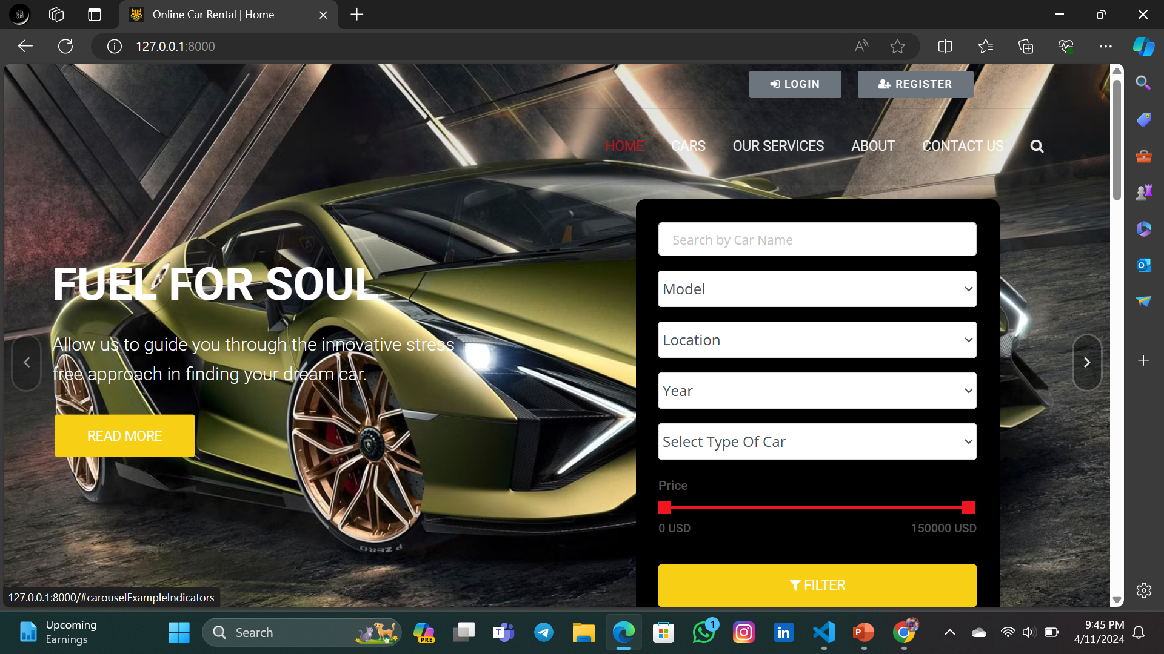
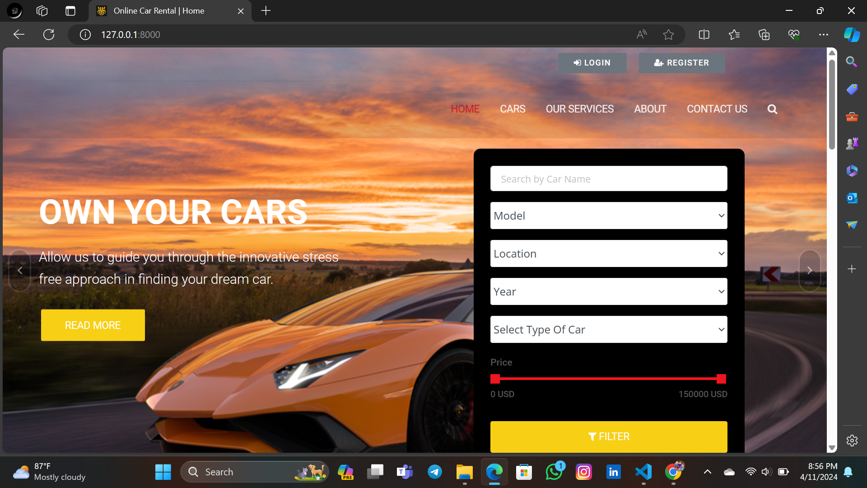
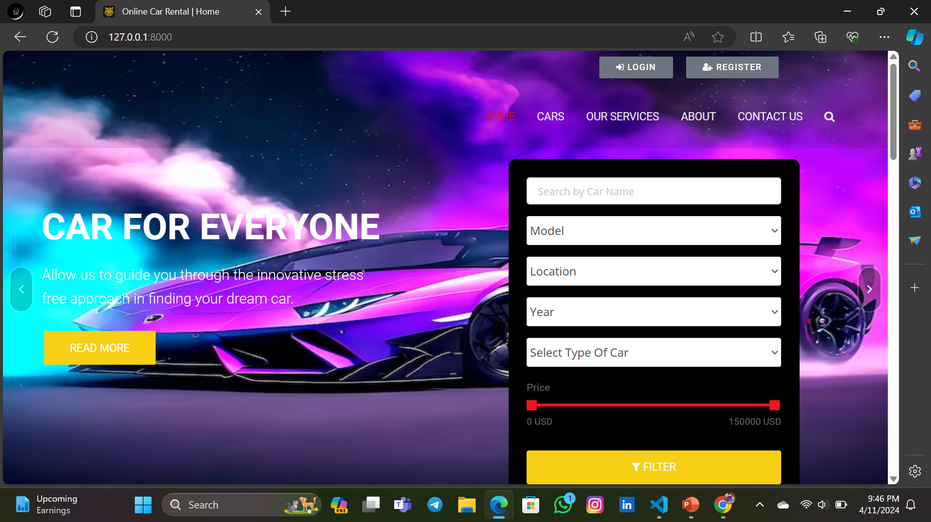
Homepage

Slide 12
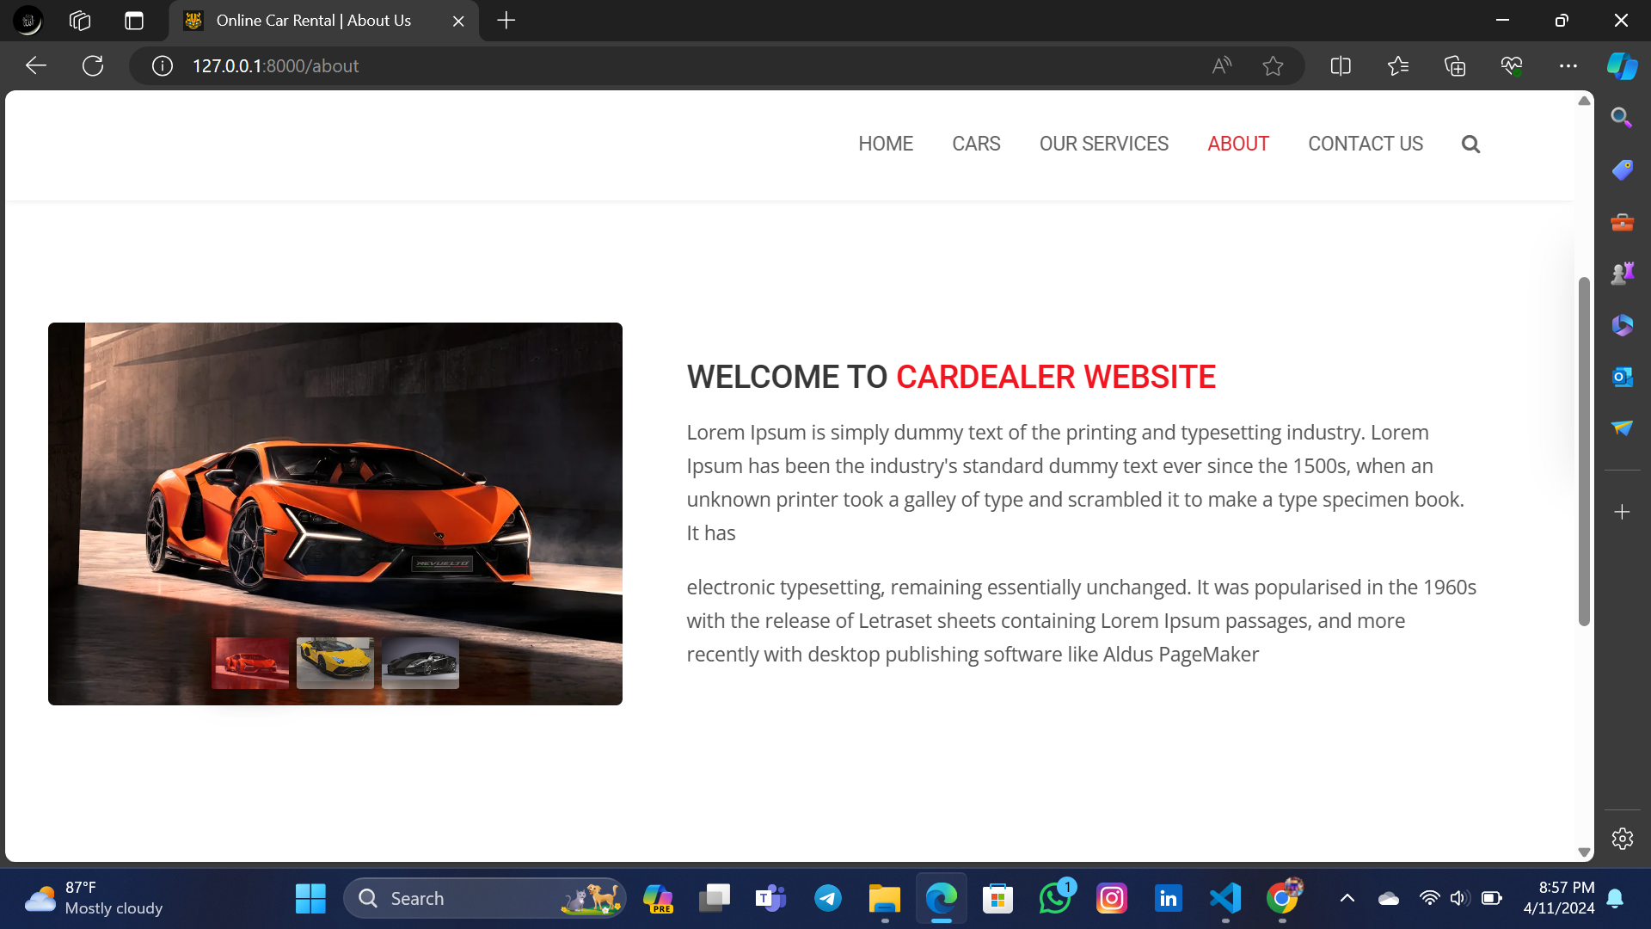
About-Us-Page

Slide 13
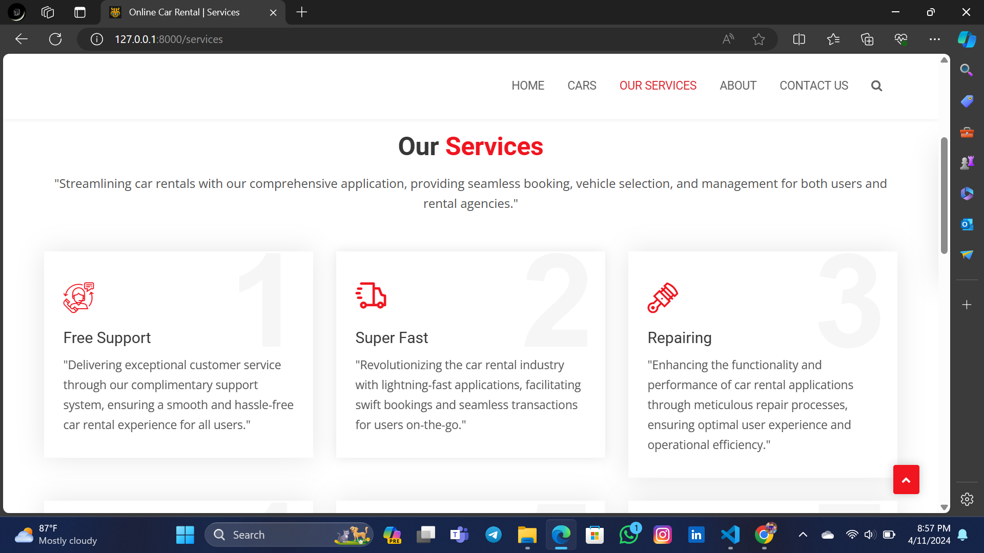
Service-Page

Slide 14
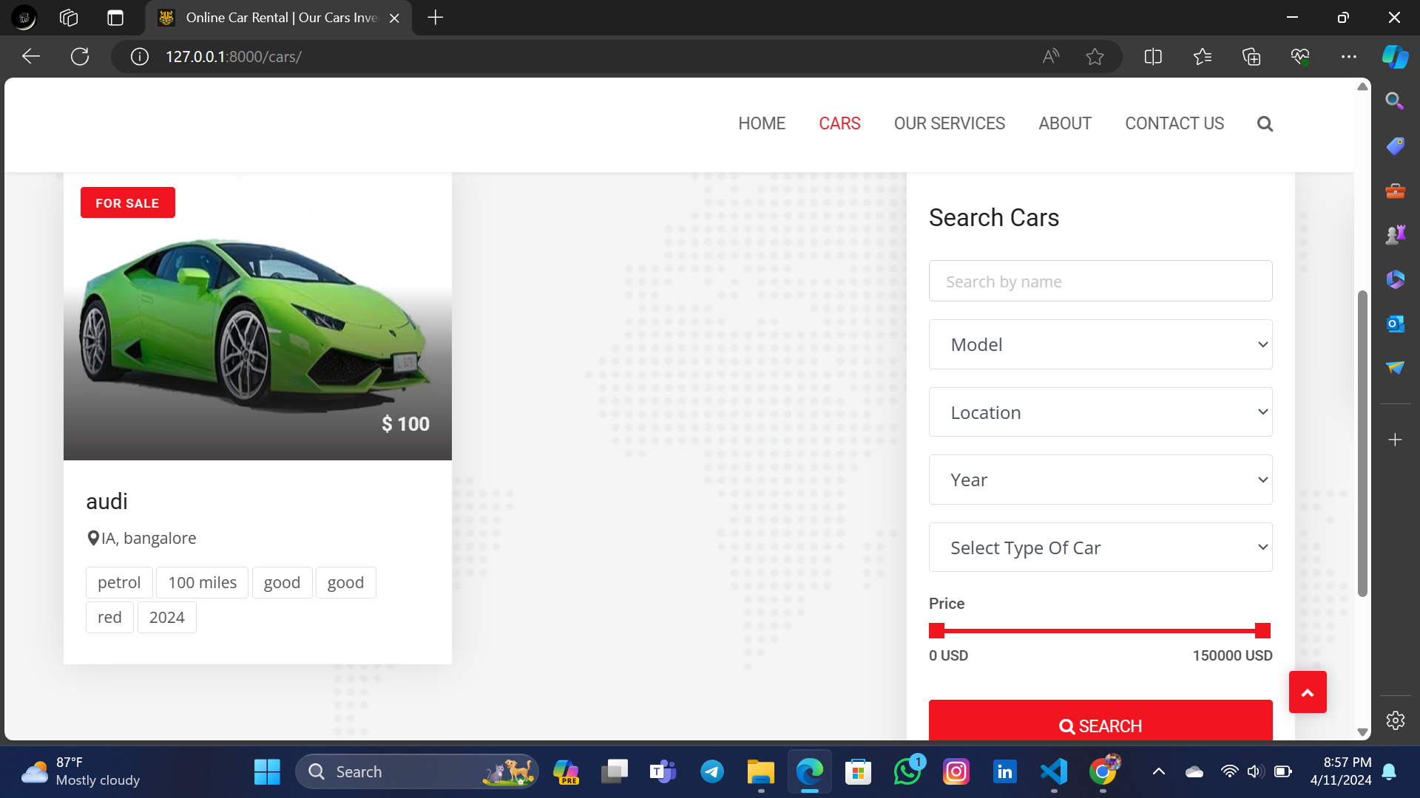
Departments-Page

Slide 15
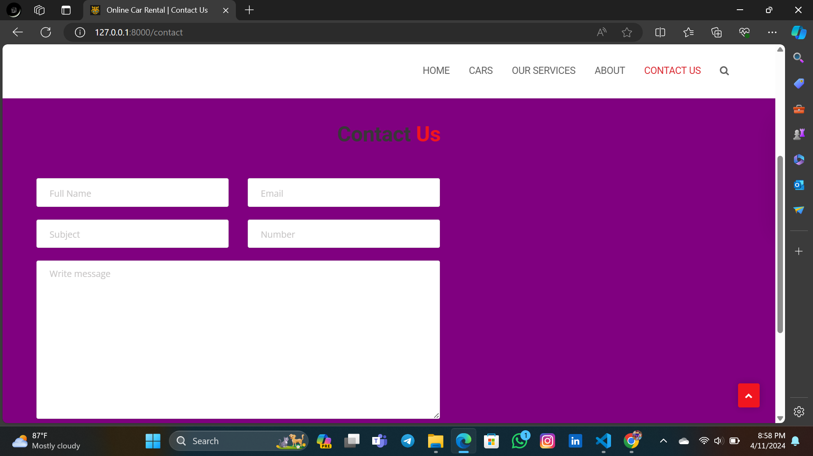
Blog-Page

Slide 16
Future Enhancements:
Some of the future enhancement for the car rental application are:
1. Predictive Analytics
2. Smart Contracts:
3. IoT Integration
4.Enhanced Mobile Experience
5.Electric and Autonomous Vehicles
6. Personalization and Loyalty Programs
7. Augmented Reality (AR) Assistance
8.Voice-Activated Interfaces
9. Collaborations and Partnerships
10. Environmental Sustainability Initiatives

Slide 17
Conclusion
In conclusion, the car rental system offers an efficient and convenient solution for individuals and businesses seeking transportation services. With its user-friendly interface, diverse vehicle options, and flexible booking arrangements, it caters to a wide range of needs. Additionally, its integration of digital platforms streamlines the reservation process, enhances communication, and ensures a seamless experience for both customers and rental agencies. Overall, the car rental system not only provides mobility but also fosters convenience, reliability, and satisfaction for all parties involved.
Source :

Slide 18
Thank You!
Notes:
Thank You !!

